Slide 1
Slide No 1 to 47
Multiple Access
12.<number>

Slide 2

Figure 12.1 Data link layer divided into two functionality-oriented sublayers
The upper sublayer that is responsible for flow and error control is called the logical link control (LLC) layer; the lower sublayer that is mostly responsible for multipleaccess resolution is called the media access control (MAC) layer.
12.<number>

Slide 3

Figure 12.2 Taxonomy of multiple-access protocols discussed in this chapter
12.<number>

Slide 4
Why Should we study Multiple Access?
When can the station access the medium?
What can the station do if the medium is busy?
How can the station determine the success or failure of the transmission?
What can the station do if there is an access conflict?

Slide 5
Figure 12.2 Taxonomy of multiple-access protocols discussed in this chapter
12.<number>

Slide 6
12-1 RANDOM ACCESS
In random access or contention methods, no station is superior to another station and none is assigned the control over another. No station permits, or does not permit, another station to send. At each instance, a station that has data to send uses a procedure defined by the protocol to make a decision on whether or not to send.
Topics discussed in this section:
ALOHA
Carrier Sense Multiple Access
Carrier Sense Multiple Access with Collision Detection
Carrier Sense Multiple Access with Collision Avoidance
12.<number>

Slide 7

Figure 12.3 Frames in a pure ALOHA network
12.<number>

Slide 8

Figure 12.4 Procedure for pure ALOHA protocol
https://www.geeksforgeeks.org/back-off-algorithm-csmacd/
12.<number>

Slide 9

Figure 12.5 Vulnerable time for pure ALOHA protocol
12.<number>

Slide 10

Figure 12.6 Frames in a slotted ALOHA network
12.<number>

Slide 11
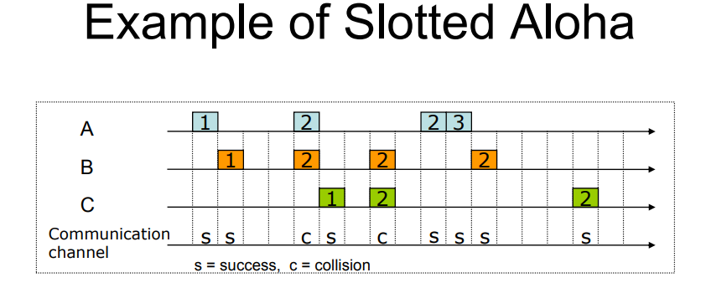
12.<number>

Slide 12
Tp - formula
Tfr - formula
Tb
K? assist to calculate Tb
R? assist to calculate Tb
Vulnerable time?
Time-out time?
12.<number>

Slide 13

Figure 12.7 Vulnerable time for slotted ALOHA protocol
12.<number>

Slide 14
Aloha
  Vulnerable Time = 2 Tfr
  Tb = RxTp, R = 0 to 2^{K}-1
  Throughput = Gxe^{-2G}
Slotted Aloha
  Vulnerable time = Tfr
  Tb
12.<number>

Slide 15
Example 12.1
The stations on a wireless ALOHA network are a maximum of 600 km apart. If we assume that signals propagate at 3 × 10⁸ m/s, we find
Tp = (600 × 10³ ) / (3 × 10⁸ ) = 2 ms.
Now we can find the value of T_{B} for different values of
K .
R = 0 to 2^{K}-1
a. For K = 1, the range is {0, 1}. The station needs to|
generate a random number with a value of 0 or 1. This
means that T_{B} is either 0 ms (0 × 2) or 2 ms (1 × 2),
based on the outcome of the random variable.
12.<number>

Slide 16
Example 12.1 (continued)
b. For K = 2, the range is {0, 1, 2, 3}. This means that T_{B}
can be 0, 2, 4, or 6 ms, based on the outcome of the
random variable.
c. For K = 3, the range is {0, 1, 2, 3, 4, 5, 6, 7}. This
means that T_{B} can be 0, 2, 4, . . . , 14 ms, based on the
outcome of the random variable.
d. We need to mention that if K > 15, it is normally set to
15.
12.<number>

Slide 17
Example 12.2
A pure ALOHA network transmits 200-bit frames on a shared channel of 200 kbps. What is the requirement to make this frame collision-free?
Solution
Average frame transmission time T_{fr} is 200 bits/200 kbps or 1 ms. The vulnerable time is 2 × 1 ms = 2 ms. This means no station should send later than 1 ms before this station starts transmission and no station should start sending during the one 1-ms period that this station is sending.
12.<number>

Slide 18
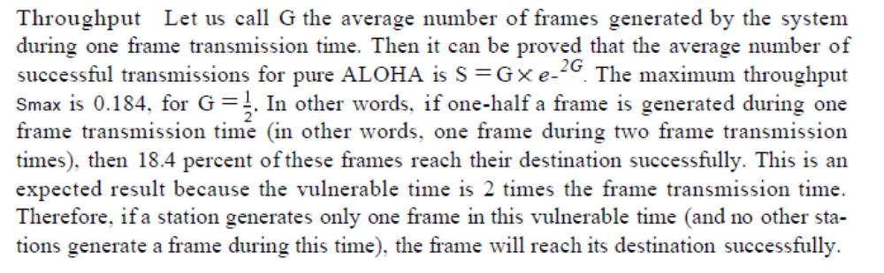
Let us call G the average number of frames generated by the system during one frame transmission time. Then it can be proved that the average number of successful transmissions for pure ALOHA is
S = G x e^{-2G}
12.<number>

Slide 19
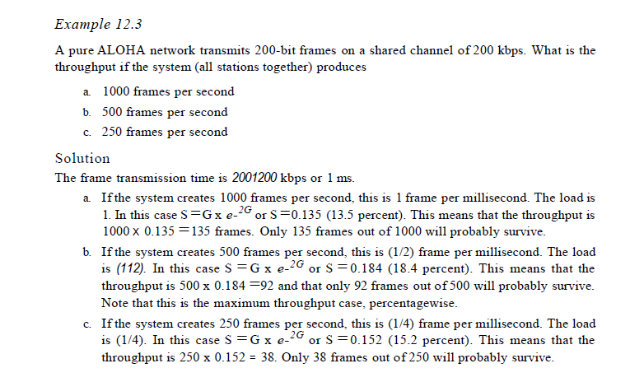


Slide 20

Note
The throughput for pure ALOHA is
S = G × e ^{−2G} .
The maximum throughput
S_{max} = 0.184 when G= (1/2).
How to get 100% throughput?
Therefore, if a station generates only one frame in this vulnerable time (and no other stations generate a frame during this time), the frame will reach its destination successfully
12.<number>

Slide 21
Example 12.3
A pure ALOHA network transmits 200-bit frames on a shared channel of 200 kbps. What is the throughput if the system (all stations together) produces
a. 1000 frames per second b. 500 frames per second
c. 250 frames per second.
Solution
The frame transmission time is 200/200 kbps or 1 ms.
a. If the system creates 1000 frames per second, this is 1
frame per millisecond. The capacity is G 1. In this case
S = G× e^{−2 G} = 1 x e -2 x 1 S = 0.135 (13.5 percent). This means that the throughput is 1000 × 0.135 = 135 frames. Only 135 frames out of 1000 will probably survive.
12.<number>

Slide 22
Example 12.3 (continued)
b. If the system creates 500 frames per second, this is
(1/2) frame per millisecond. The load is (1/2). In this
case S = G × e ^{−2G} or S = 0.184 (18.4 percent). This
means that the throughput is 500 × 0.184 = 92 and that
only 92 frames out of 500 will probably survive. Note
that this is the maximum throughput case,
percentagewise.
c. If the system creates 250 frames per second, this is (1/4)
frame per millisecond. The load is (1/4). In this case
S = G × e −^{2G} or S = 0.152 (15.2 percent). This means
that the throughput is 250 × 0.152 = 38. Only 38
frames out of 250 will probably survive.
12.<number>

Slide 23
Note
The throughput for slotted ALOHA is
S = G × e^{−G} .
The maximum throughput
S_{max} = 0.368 when G = 1.
12.<number>

Slide 24
Example 12.4
A slotted ALOHA network transmits 200-bit frames on a shared channel of 200 kbps. What is the throughput if the system (all stations together) produces
a. 1000 frames per second b. 500 frames per second
c. 250 frames per second.
Solution
The frame transmission time is 200/200 kbps or 1 ms.
a. If the system creates 1000 frames per second, this is 1
frame per millisecond. The load is 1. In this case
S = G× e^{−G} or S = 0.368 (36.8 percent). This means
that the throughput is 1000 × 0.0368 = 368 frames.
Only 386 frames out of 1000 will probably survive.
12.<number>

Slide 25
Example 12.4 (continued)
b. If the system creates 500 frames per second, this is
(1/2) frame per millisecond. The load is (1/2). In this
case S = G × e^{−G} or S = 0.303 (30.3 percent). This
means that the throughput is 500 × 0.0303 = 151.
Only 151 frames out of 500 will probably survive.
c. If the system creates 250 frames per second, this is (1/4)
frame per millisecond. The load is (1/4). In this case
S = G × e ^{−G} or S = 0.195 (19.5 percent). This means
that the throughput is 250 × 0.195 = 49. Only 49
frames out of 250 will probably survive.
12.<number>

Slide 26
CSMA
To minimize the chance of collision and, therefore, increase the performance, the CSMA method was developed.
CSMA is based on the principle "sense before transmit" or "listen before talk.“
Reason for collision - a station may sense the medium and find it idle, only because the first bit sent by another station has not yet been received.
12.<number>

Slide 27
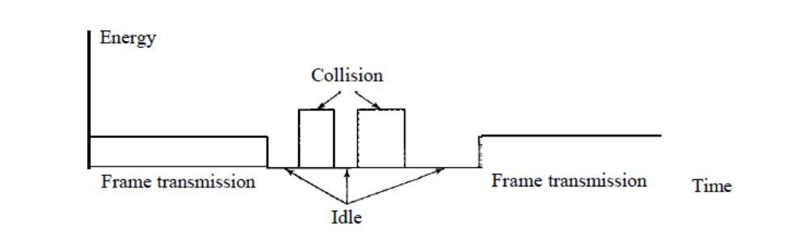
Find the status of transmission
Status – idle, data tranmission,collision
?
?
?
?
?
12.<number>

Slide 28

Figure 12.15 Energy level during transmission, idleness, or collision
12.<number>

Slide 29

Figure 12.8 Space/time model of the collision in CSMA
CSMA can reduce the possibility of collision, but it cannot eliminate it.
At time t1, station B senses the medium and finds it idle, so it sends a frame. At time
t2 (t2> t1)' station C senses the medium and finds it idle because, at this time, the first
bits from station B have not reached station C. Station C also sends a frame. The two
signals collide and both frames are destroyed
12.<number>

Slide 30
CSMA can reduce the possibility of collision, but it cannot eliminate it.
Propagation delay is playing major role in Collision
12.<number>

Slide 31

Figure 12.9 Vulnerable time in CSMA
t2
t3
t4
t7
The vulnerable time for CSMA is the propagation time Tp . This is the time needed for a signal to propagate from one end of the medium to the other. When a station sends a frame, and any other station tries to send a frame during this time, a collision will result. But if the first bit of the frame reaches the end of the medium, every station will already have heard the bit and will refrain from sending
12.<number>

Slide 32
Why the vulnerable time in ALOHA depends on TFR?
This is because of the difference in the magnitude of Transmission time and Propogation time. Most propogation is done through EM waves and thus for most distances the propogation delay is very negligible as compared to transmission time which is limited by the Bandwidth of a channel.
12.<number>

Slide 33

Figure 12.10 Behavior of three persistence methods
What should a station do if the channel is busy?
What should a station do if the channel
is idle?
https://www.geeksforgeeks.org/difference-between-1-persistent-p-persistent-and-non-persistent-csma/
12.<number>

Slide 34

Figure 12.11 Flow diagram for three persistence methods
12.<number>

Slide 35

Figure 12.12 Collision of the first bit in CSMA/CD
At time t 1, station A has executed its persistence procedure and starts sending the
bits of its frame. At time t2, station C has not yet sensed the first bit sent by A. Station C executes its persistence procedure and starts sending the bits in its frame, which propagate both to the left and to the right. The collision occurs sometime after time t2' Station C detects a collision at time t3 when it receives the first bit of A's frame. Station C immediately (or after a short time, but we assume immediately) aborts transmission. Station A detects collision at time t4 when it receives the first bit of C's frame; it also immediately aborts transmission. Looking at the figure, we see that A transmits for the duration t4 - tl; C transmits for the duration t3 - t2'. . At time t4, the transmission of A:s frame, though incomplete, is aborted; at time t3, the transmission of B's frame, though incomplete, is aborted
12.<number>

Slide 36

Figure 12.13 Collision and abortion in CSMA/CD
Frame Size
For CSMAlCD to work, we need a restriction on the frame size. Before sending the last bit of the frame, the sending station must detect a collision, if any, and abort the transmission. This is so because the station, once the entire frame is sent, does not keep a copy of the frame and does not monitor the line for collision detection. Therefore, the frame transmission time Tfr must be at least two times the maximum propagation time Tp. To understand the reason, let us think about the worst-case scenario. If the two stations involved in a collision are the maximum distance apart, the signal from the first takes time Tp to reach the second, and the effect of the collision takes another time Tp to reach the first. So the requirement is that the first station must still be transmitting after 2Tp .
12.<number>

Slide 37
Minimum Frame Size
For CSMAlCD to work, we need a restriction on the frame size. Before sending the last
bit of the frame, the sending station must detect a collision, if any, and abort the transmission.
This is so because the station, once the entire frame is sent, does not keep a copy of
the frame and does not monitor the line for collision detection. Therefore, the frame transmission
time Tfr must be at least two times the maximum propagation time Tp. To understand
the reason, let us think about the worst-case scenario. If the two stations involved in
a collision are the maximum distance apart, the signal from the first takes time Tp to reach
the second, and the effect of the collision takes another time Tp to reach the first. So the
requirement is that the first station must still be transmitting after 2Tp
How 2tp?
T_{fr}>2T_{p}
Tranmission time must be greater than 2 times of prop. time
12.<number>

Slide 38

Figure 12.14 Flow diagram for the CSMA/CD
12.<number>

Slide 39
Note
In CSMA/CA, the IFS can also be used to define the priority of a station or a frame.
Carrier sense multiple access with collision avoidance (CSMA/CA) was invented to avoid collisions on wireless networks. Collisions are avoided through the use of CSMAICA's three strategies: the interframe, space, the contention window, and acknowledgments
12.<number>

Slide 40
Note
In CSMA/CA, if the station finds the channel busy, it does not restart the timer of the contention window;
it stops the timer and restarts it when the channel becomes idle.
12.<number>

Slide 41

Figure 12.16 Timing in CSMA/CA
Collision Avoidance
Contention Window: A station that is ready to send chooses a random number of slots as its wait time. The number of slots in the window changes according to the binary exponential back-off strategy. This means that it is set to one slot the first time and then doubles each time the station cannot detect an idle channel after the IFS time. This is very similar to the p-persistent method
12.<number>

Slide 42

Flow diagram for CSMA/CA
12.<number>

Slide 43
ALOHA – don’t sense medium, start tr when data ready – collision – high – 2Tfr
Slotted ALOHA – Tfr- don’t sense the medium, starting of the slot to access
Different Persistence – sender to access the medium in different time
CSMA – sense medium, start transmisson – low - Tp
CSMA/CD – helping to detect collision – Tfr>2Tp
CSMA/CA – IFS+Contention window by binary exponential - R – 2^{K}-1 – K – 0 to 15
12.<number>

Slide 44
Qn1 :
  In a CSMA / CD network running at 1 Gbps over 1 km cable with no repeaters, the signal speed in the cable is 200000 km/sec. What is minimum frame size?
Qn2 :
  A and B are the only two stations on an Ethernet. Each has a steady queue of frames to send. Both A and B attempt to transmit a frame, collide, and A wins the first backoff race. At the end of this successful transmission by A, both A and B attempt to transmit and collide. The probability that A wins the second backoff race is:
  Qn3:
  Suppose nodes A and B are on same 10 Mbps Ethernet segment and the propagation delay between two nodes is 225 bit times. Suppose A and B send frames at t=0, the frames collide then at what time, they finish transmitting a jam signal. Assume a 48 bit jam signal
12.<number>

Slide 45
Qn1 – Ans
  Distance / Propagation speed - 1 km / (200000 km/sec) = 5 x 10⁻⁶ sec
Calculating Minimum Frame Size-
Minimum frame size - 2 x Propagation delay x Bandwidth - 2 x 5 x 10⁻⁶ sec x 10⁹ bits per sec = 10000 bits
Qn2 – Ans
  1st attempt: Value of ‘k’ would be k=0 or k=1 (0 <= k <= 2^n-1; where n=nth attempt). Since A won the first race, A must have chosen k=0 and B must have chosen k=1 (A wins here with probability 0.25). As A won, A will again choose k=0 or k=1 for its 2nd frame, but B will choose k=0,1,2 or 3 as B failed to send its first frame in the first attempt.
  2nd attempt: Let kA= value of k chosen by A and kB = value of k chosen by B. We will use notation (kA,kB) to show the possible values. Now the sample space for the 2nd attempt is (kA,kB) = (0,0),(0,1),(0,2),(0,3),(1,0),(1,1),(1,2) or (1,3) i.e. 8 possible outcomes. For A to win, kA should be less than kB (kA < kB). Thus, our event space is (kA, kB) = (0,1),(0,2),(0,3),(1,2),(1,3) i.e. 5 possible outcomes.
  Thus the probability that A wins the 2nd back-off race = 5/8 = 0.625
12.<number>

Slide 46
Qn3
.
Solution-
Propagation delay (T_{p})
= = 225 bit / 10 Mbps - 22.5 μsec
At t = 0,
Nodes A and B start transmitting their frame.
Since both the stations start simultaneously, so collision occurs at the mid way.
Time after which collision occurs = Half of propagation delay.
So, time after which collision occurs = 22.5 μsec / 2 = 11.25 μsec.
At t = 11.25 μsec,
After collision occurs at t = 11.25 μsec, collided signals start travelling back.
Collided signals reach the respective nodes after time = Half of propagation delay
Collided signals reach the respective nodes after time = 22.5 μsec / 2 = 11.25 μsec.
Thus, at t = 22.5 μsec, collided signals reach the respective nodes.
At t = 22.5 μsec,
As soon as nodes discover the collision, they immediately release the jam signal.
Time taken to finish transmitting the jam signal = 48 bit time = 48 bits/ 10 Mbps = 4.8 μsec.
Thus,
Time at which the jam signal is completely transmitted
= 22.5 μsec + 4.8 μsec
= 27.3 μsec or 273 bit times
12.<number>

Slide 47
Example 12.5
A network using CSMA/CD has a bandwidth of 10 Mbps. If the maximum propagation time (including the delays in the devices and ignoring the time needed to send a jamming signal, as we see later) is 25.6 μs, what is the minimum size of the frame?
Solution
The frame transmission time is T_{fr} = 2 × T_{p} = 51.2 μs. This means, in the worst case, a station needs to transmit for a period of 51.2 μs to detect the collision. The minimum size of the frame is 10 Mbps × 51.2 μs = 512 bits or 64 bytes. This is actually the minimum size of the frame for Standard Ethernet.
12.<number>

Slide 48
12-2 CONTROLLED ACCESS
In controlled access, the stations consult one another to find which station has the right to send. A station cannot send unless it has been authorized by other stations. We discuss three popular controlled-access methods.
Topics discussed in this section:
Reservation
Polling
Token Passing
12.<number>

Slide 49

Figure 12.18 Reservation access method
12.<number>

Slide 50

Figure 12.19 Select and poll functions in polling access method
12.<number>

Slide 51

Figure 12.20 Logical ring and physical topology in token-passing access method
12.<number>

Slide 52
IEEE 802.11 – Class Assignment
12.<number>

Slide 53
12-3 CHANNELIZATION
Channelization is a multiple-access method in which the available bandwidth of a link is shared in time, frequency, or through code, between different stations. In this section, we discuss three channelization protocols.
Topics discussed in this section:
Frequency-Division Multiple Access (FDMA)
Time-Division Multiple Access (TDMA)
Code-Division Multiple Access (CDMA)
12.<number>

Slide 54
Note
We see the application of all these methods in Chapter 16 when
we discuss cellular phone systems.
12.<number>

Slide 55

Figure 12.21 Frequency-division multiple access (FDMA)
12.<number>

Slide 56
Note
In FDMA, the available bandwidth
of the common channel is divided into bands that are separated by guard bands.
12.<number>

Slide 57

Figure 12.22 Time-division multiple access (TDMA)
12.<number>

Slide 58
Note
In TDMA, the bandwidth is just one channel that is timeshared between different stations.
12.<number>

Slide 59
Note
In CDMA, one channel carries all transmissions simultaneously.
12.<number>

Slide 60

Figure 12.23 Simple idea of communication with code
12.<number>

Slide 61
Figure 12.24 Chip sequences
12.<number>

Slide 62
Figure 12.25 Data representation in CDMA
12.<number>

Slide 63

Figure 12.26 Sharing channel in CDMA
12.<number>

Slide 64

Figure 12.27 Digital signal created by four stations in CDMA
12.<number>

Slide 65

Figure 12.28 Decoding of the composite signal for one in CDMA
12.<number>

Slide 66

Figure 12.29 General rule and examples of creating Walsh tables
12.<number>

Slide 67
Note
The number of sequences in a Walsh table needs to be N = 2^{m}.
12.<number>

Slide 68
Example 12.6
Find the chips for a network with
a. Two stations b. Four stations
Solution
We can use the rows of W2 and W4 in Figure 12.29:
a. For a two-station network, we have
[+1 +1] and [+1 −1].
b. For a four-station network we have
[+1 +1 +1 +1], [+1 −1 +1 −1],
[+1 +1 −1 −1], and [+1 −1 −1 +1].
12.<number>

Slide 69
Example 12.7
What is the number of sequences if we have 90 stations in our network?
Solution
The number of sequences needs to be 2^{m}. We need to choose m = 7 and N = 2⁷ or 128. We can then use 90
of the sequences as the chips.
12.<number>

Slide 70
Example 12.8
Prove that a receiving station can get the data sent by a specific sender if it multiplies the entire data on the channel by the sender’s chip code and then divides it by the number of stations.
Solution
Let us prove this for the first station, using our previous four-station example. We can say that the data on the channel
D = (d1 ⋅ c1 + d2 ⋅ c2 + d3 ⋅ c3 + d4 ⋅ c4).
The receiver which wants to get the data sent by station 1 multiplies these data by c1.
12.<number>

Slide 71

Example 12.8 (continued)
When we divide the result by N, we get d1 .
12.<number>

